Slide 1
TensorFlow Lite Pipeline
Sajjad Hussain

Slide 2
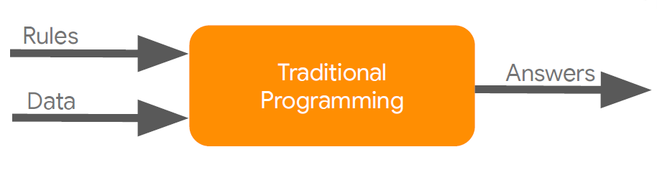
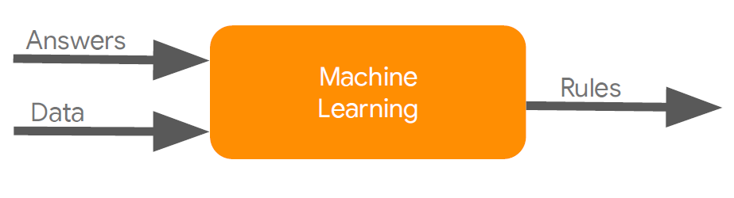
Machine Learning
Traditional Programming
Machine Learning

Slide 3
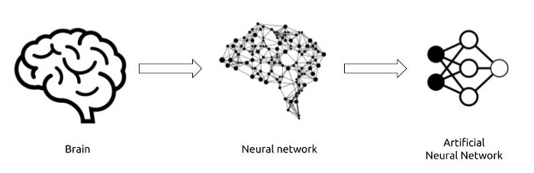
TensorFlow Lite
TensorFlow Lite is designed to perform deep learning tasks: a type of machine learning based on artificial neural networks.
An artificial neural network (ANN) is a mechanism which mimics how a human brain learns. It is an interconnected group of nodes, inspired by a simplification of neurons in a brain.
The simplest type of ANN is the sequential model: a linear stack of layers where each layer has exactly one input and one output tensor.
A tensor is the mathematical representation of a neuron.
TensorFlow uses the keras open-source library to build neural networks in python.

Slide 4
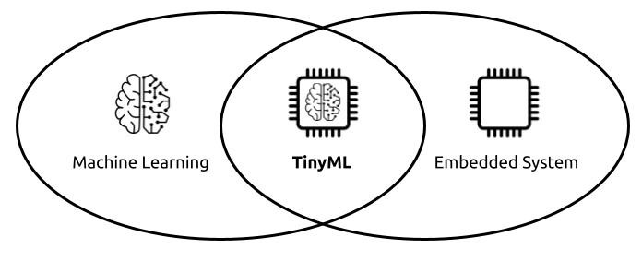
TensorFlow Lite
Tiny Machine Learning (TinyML) is a field at the intersection of embedded IOT systems and machine learning.
TensorFlow Lite is designed to make easy to perform machine learning on devices “at the edge” of the network, instead of sending data back and forth from a server.
TensorFlow Lite is a production ready, cross-platform framework for deploying ML on mobile devices and embedded systems.
It enables machine learning inference with low latency and a small program size on devices with limited compute and memory resources.
It works with a huge range of devices: from low-power microcontrollers (Arduino) to powerful mobile phones (Android, iOS).

Slide 5
The TensorFlow Lite Workflow
The TensorFlow Lite workflow involves the following steps:
Train the model (Google Colab)
A TensorFlow model is a data structure that contains the logic and knowledge of a machine learning network trained to solve a particular problem.
You cannot build a model using TensorFlow Lite.
You must convert a regular TensorFlow model into the Lite format.
If your model is trained for microcontroller, you have to generate a small TensorFlow model that can fit your tiny device with some limitations.
Convert and optimize the model
Convert the TensorFlow model in TensorFlow Lite format using TensorFlow Lite converter.
Converting models reduces size and introduces optimizations that do not affect accuracy, with some trade-offs.
Deploy and run the model (Arduino)
Deploy and run your model on-device with the interpreter.

Slide 6
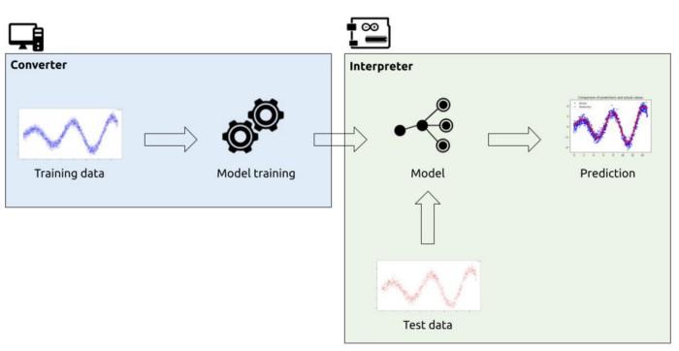
TensorFlow Lite: Inference
Inference is the process of running data through a model to obtain predictions. It requires a model, an interpreter, and input data.
TensorFlow Lite is composed by two main components:
Converter: converts TensorFlow models into an efficient form used by the interpreter.
Interpreter: runs optimized models (aka, run inference) on mobile and embedded devices.
Interpreter can be configured to run on: mobile platforms (Android, iOS), Embedded Linux and microcontrollers.

Slide 7
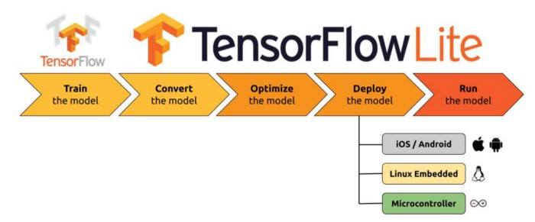
TensorFlow Lite: Pipeline
A machine learning pipeline is the end-to-end construct that orchestrates the flow of data into, and output from, a machine learning model.
It includes raw data input, features, outputs, the machine learning model and model parameters, and prediction outputs.

Slide 8
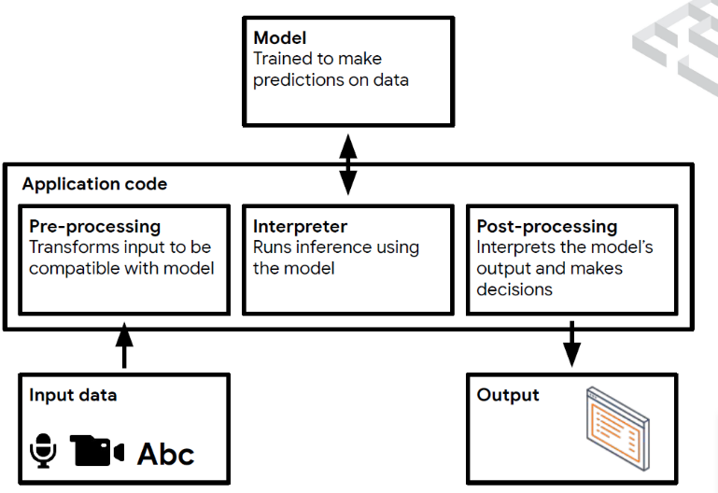
TensorFlow Lite: Pipeline
TensorFlow Lite Workflow: Main 2 Steps
Get a TensorFlow Lite model (Google Colab)
Deploy and run on edge device (Arduino Sketch)
Detailed Steps:
Develop a TensorFlow model in Google Colab
Train and Validate it
Convert it to TensorFlow Lite model
Call this TensorFlow Lite model into a C Array
Instantiate the interpreter and TFLite model
Configure the mode
Invoke the inference

Slide 9
Development Workflow
Generate a TensorFlow Lite model
A TensorFlow Lite model is represented in a special efficient portable format known as FlatBuffers (identified by the .tflite extension).
You can generate a TensorFlow Lite model in the following ways:
Use an existing TensorFlow Lite model: Refer to TensorFlow Lite Examples to pick an existing model.
Create a TensorFlow Lite model: Use the TensorFlow Lite Model Maker to create a model with your own custom dataset.
Convert a TensorFlow model into a TensorFlow Lite model: Use the TensorFlow Lite Converter to convert a TensorFlow model into a TensorFlow Lite model. During conversion, you can apply optimizations such as quantization to reduce model size and latency with minimal or no loss in accuracy.
Run Inference
Inference refers to the process of executing a TensorFlow Lite model on-device to make predictions based on input data.

Slide 10
Development Workflow: Arduino Sketch
Include the library headers: To use the TensorFlow Lite for Microcontrollers library
Include the model header: interpreter expects the model to be provided as a C++ array
Include the unit test framework header: in order to create a unit test
Set up logging: variable will be passed into the interpreter, which allows it to write logs
Load a model: the model is instantiated using data from a char array
Instantiate operations resolver: used by the interpreter to access the model’s operations
Allocate memory: need to preallocate a certain memory for in/output, and intermediate arrays
Instantiate interpreter: create MicroInterpreter instance, passing the variables created earlier
Allocate tensors: tell interpreter to allocate memory from the tensor_arena for model's tensors
Validate input shape: to confirm that tensor shape and type are what we are expecting
Provide an input value: to provide an input to the model
Run the model: to run the model, we can call Invoke()
Obtain the output: model's output tensor can be obtained by calling output(0)
Run inference again: remainder of the code runs inference several more times

